Slide 1
Predicting Movie Domestic Box Office
Will Tseng

Slide 2
Question
Are we able to know how successful a movie will be early on in its pre-release and early post -release phase?
Notes:
Any indicators of how successful a movie will be?

Slide 3
Data Source
IMDB (2007 – 2017)

Slide 6
Data Source
IMDB (2007 – 2017)
Bureau of Labor Statistics

Slide 7
Model
Linear regression

Slide 8
Model
Linear regression
Target variable:

Slide 9
Model
Linear regression
Target variable:
total domestic gross

Slide 10
Model
Linear regression
Target variable:
total domestic gross
Inputs:
Notes:
After careful feature selection methods with Lasso, Ridge, and with p-values, it really came down to these 4 variables

Slide 11
Model
Linear regression
Target variable:
total domestic gross
Inputs:
production budget
Notes:
production budget data available upon movie release

Slide 12
Model
Linear regression
Target variable:
total domestic gross
Inputs:
production budget
opening weekend gross

Slide 13
Model
Linear regression
Target variable:
total domestic gross
Inputs:
production budget
opening weekend gross
IMDB score rating
Notes:
production budget data available upon movie release

Slide 14
Model
Linear regression
Target variable:
total domestic gross
Inputs:
production budget
opening weekend gross
IMDB score rating
FB likes

Slide 15
Test Results

Slide 16
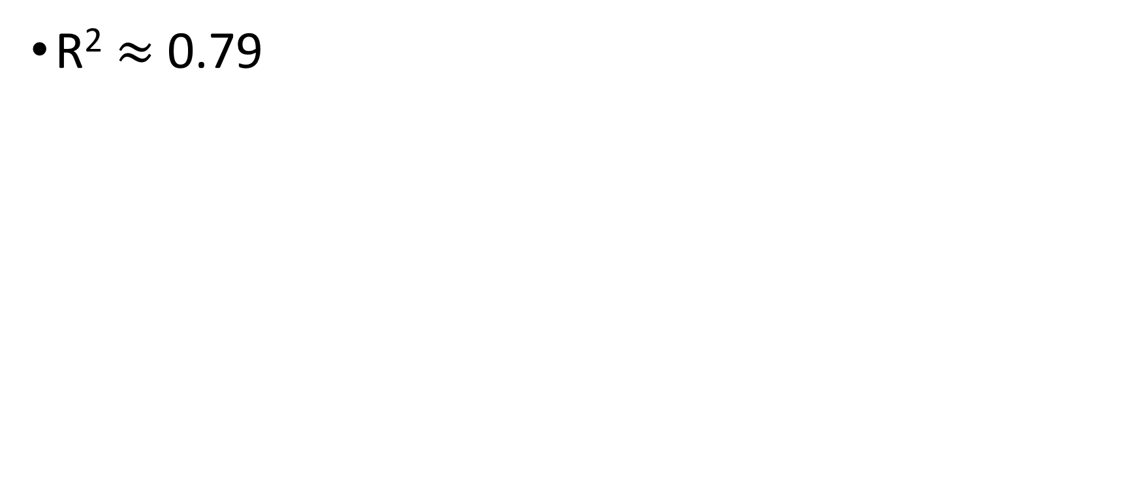
Test Results
R² $≈$ 0.79

Slide 17
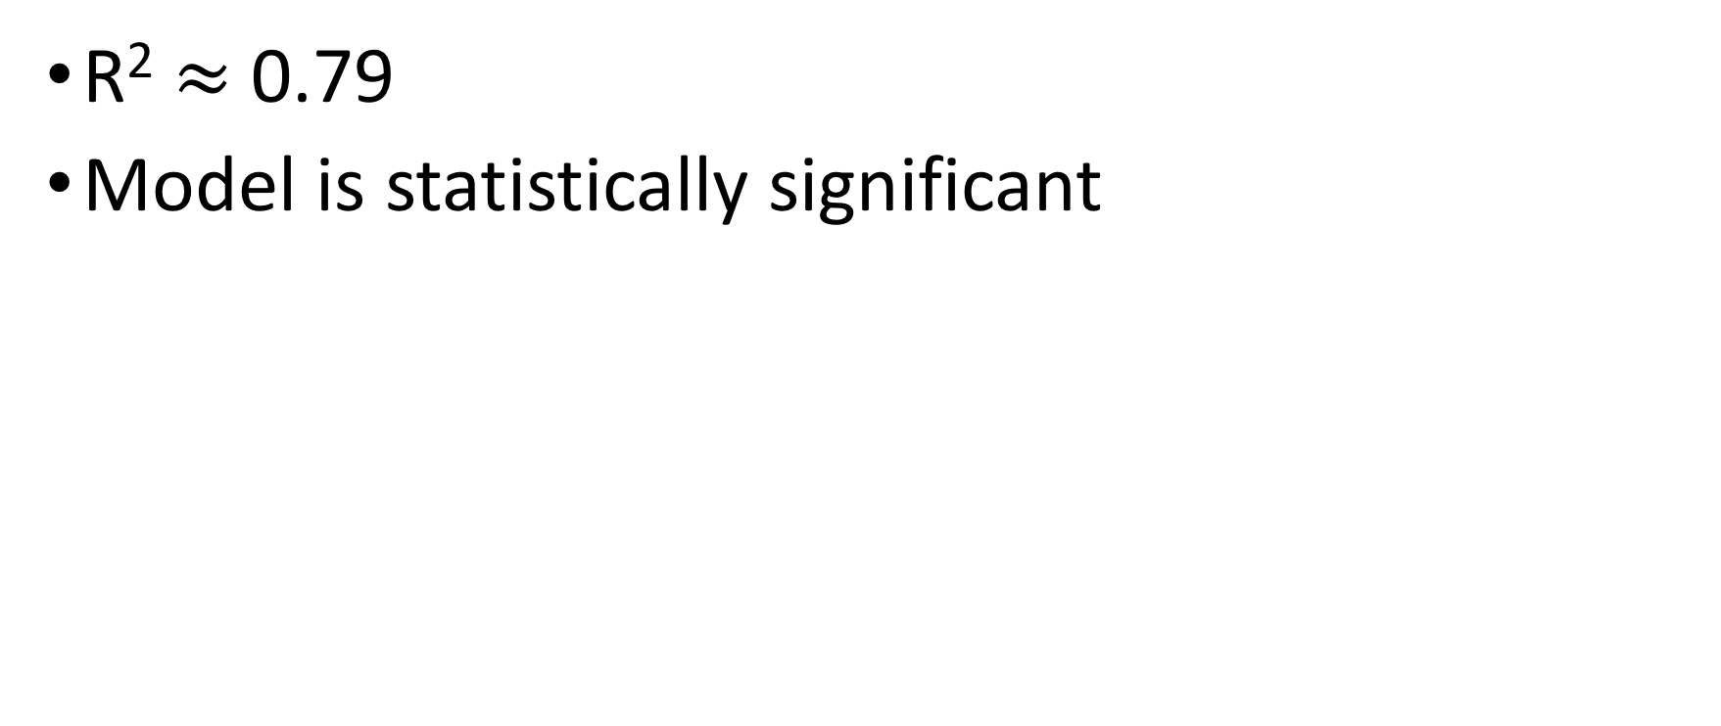
Test Results
R² $≈$ 0.79
Model is statistically significant

Slide 18
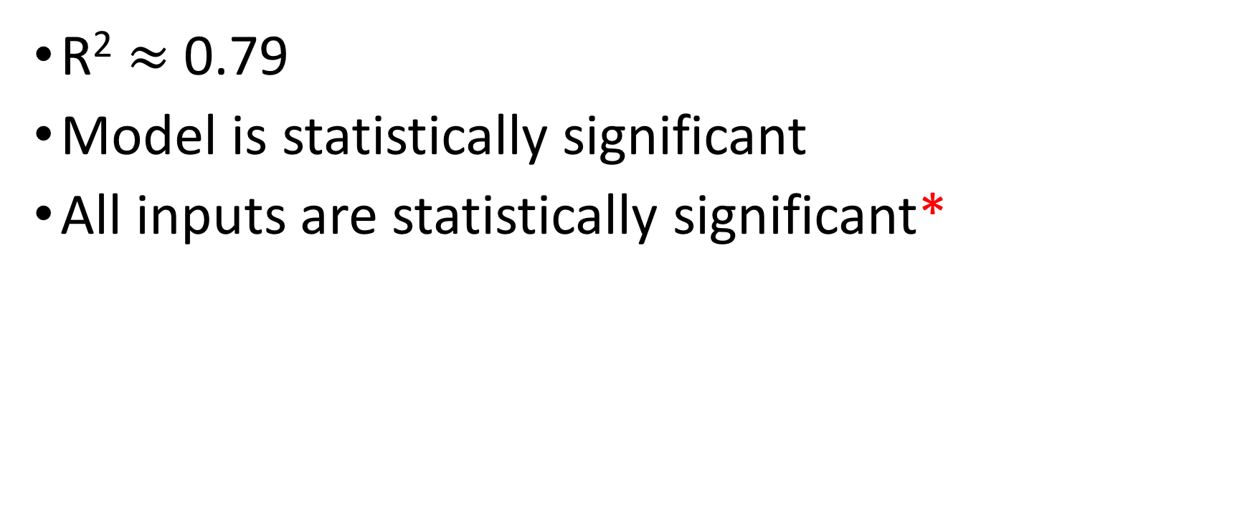
Test Results
R² $≈$ 0.79
Model is statistically significant
All inputs are statistically significant*

Slide 19
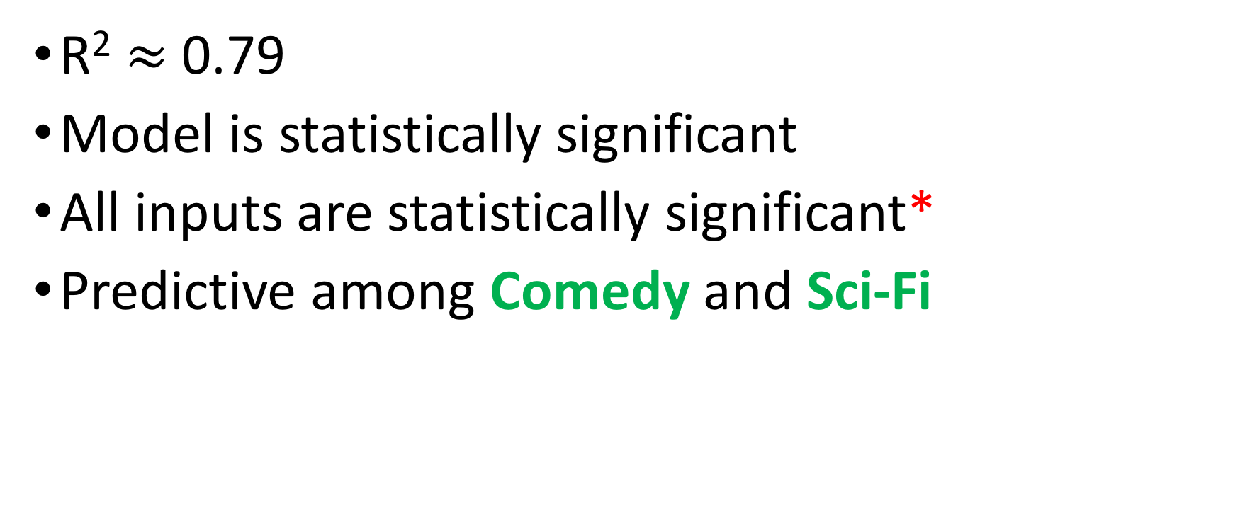
Test Results
R² $≈$ 0.79
Model is statistically significant
All inputs are statistically significant*
Predictive among Comedy and Sci-Fi
Notes:
probably because these genres are more receptive among general audiences so some of the input variables are more consistent

Slide 20
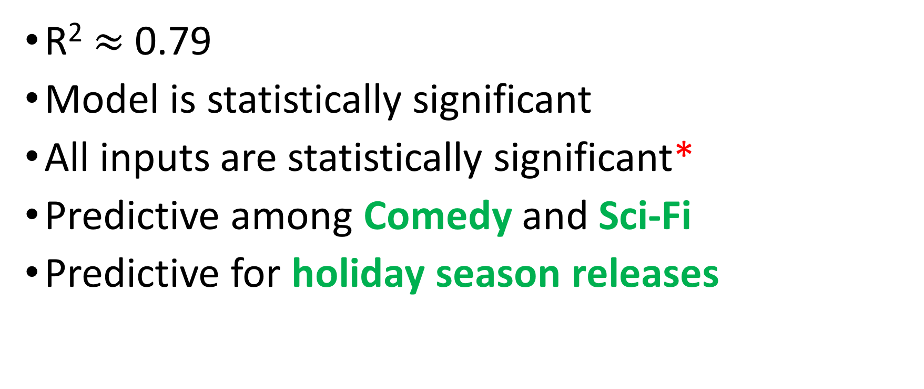
Test Results
R² $≈$ 0.79
Model is statistically significant
All inputs are statistically significant*
Predictive among Comedy and Sci-Fi
Predictive for holiday season releases

Slide 21
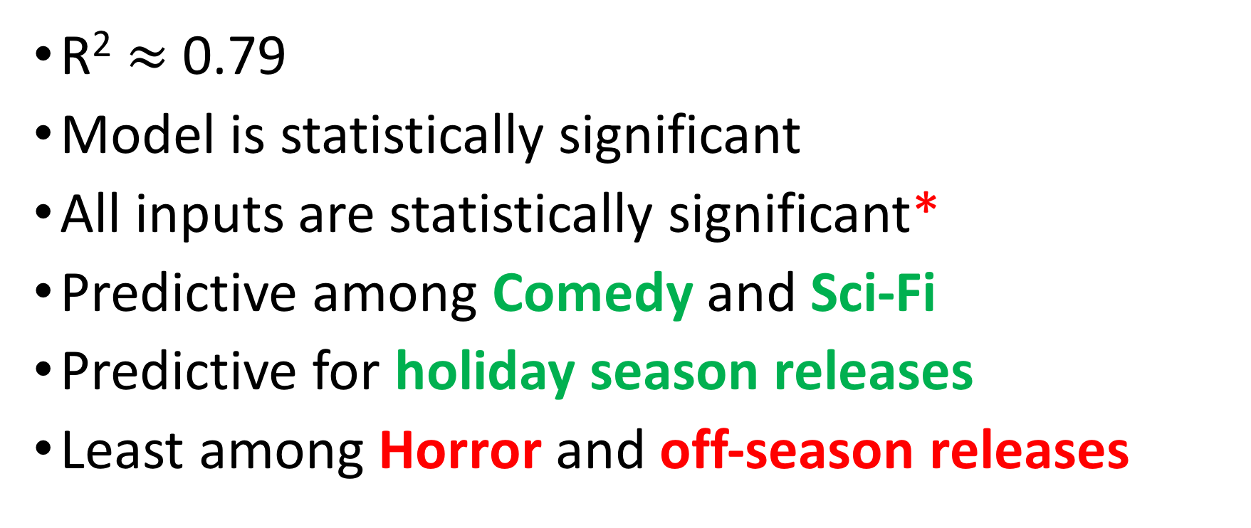
Test Results
R² $≈$ 0.79
Model is statistically significant
All inputs are statistically significant*
Predictive among Comedy and Sci-Fi
Predictive for holiday season releases
Least among Horror and off-season releases
Notes:
In general receptive among a narrower group of audience

Slide 22
Findings
Notes:
Data is quite scattered but you can still make out a general linear relationship among the the variables

Slide 24
FB Likes

Slide 25
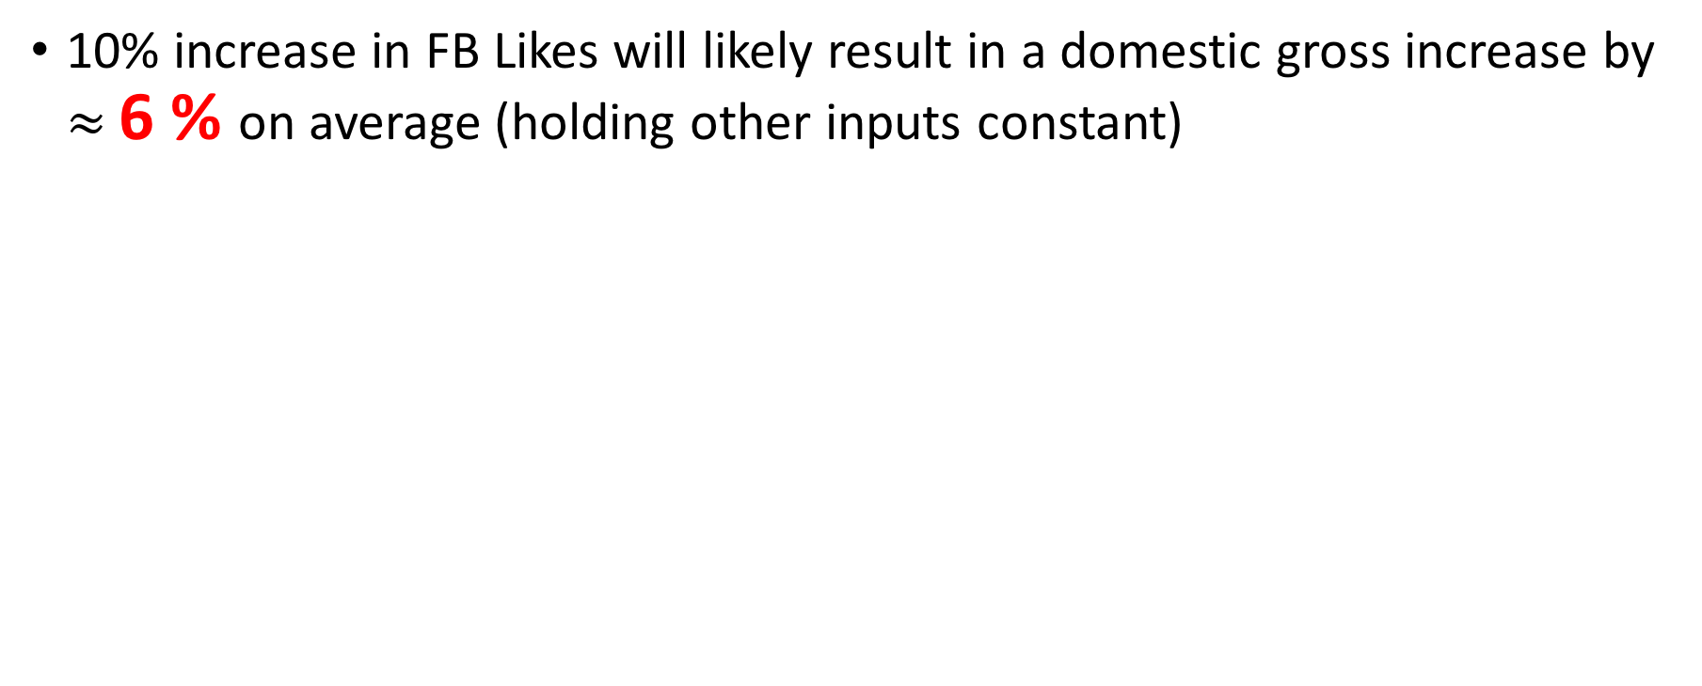
FB Likes
10% increase in FB Likes will likely result in a domestic gross increase by $≈$ 6 % on average (holding other inputs constant)

Slide 26
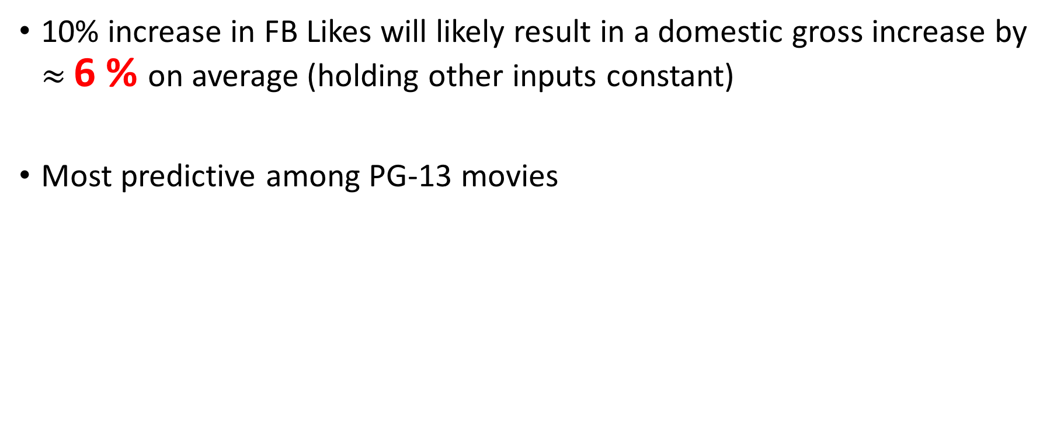
FB Likes
10% increase in FB Likes will likely result in a domestic gross increase by $≈$ 6 % on average (holding other inputs constant)
Most predictive among PG-13 movies

Slide 27
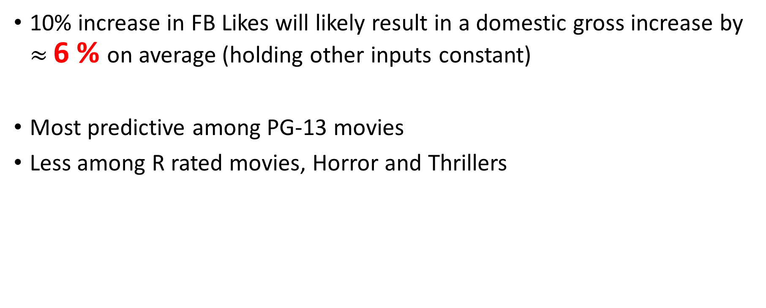
FB Likes
10% increase in FB Likes will likely result in a domestic gross increase by $≈$ 6 % on average (holding other inputs constant)
Most predictive among PG-13 movies
Less among R rated movies, Horror and Thrillers

Slide 28
Notes:
on first sight, not really any relationship
Trying to infer the relationship between variables on a scatter plot can be misleading
As you know correlation does not imply causal relationship
so in reality x could in fact have a causal relationship with y. a third variable z could mask that relationship. thankfully this can be solved

Slide 29
IMDB score rating

Slide 30
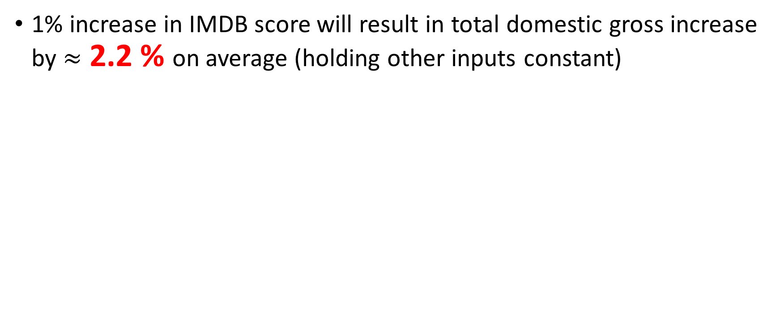
IMDB score rating
1% increase in IMDB score will result in total domestic gross increase by $≈$ 2.2 % on average (holding other inputs constant)

Slide 31
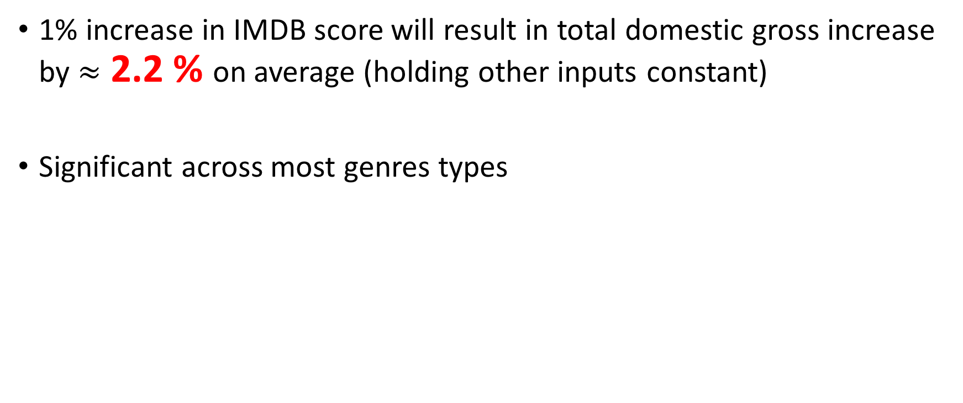
IMDB score rating
1% increase in IMDB score will result in total domestic gross increase by $≈$ 2.2 % on average (holding other inputs constant)
Significant across most genres types

Slide 33
Production Budget

Slide 34

Production Budget
10 % increase in prod. budget will increase the total domestic gross by $≈$ 1 % on average (holding other inputs constant)

Slide 35
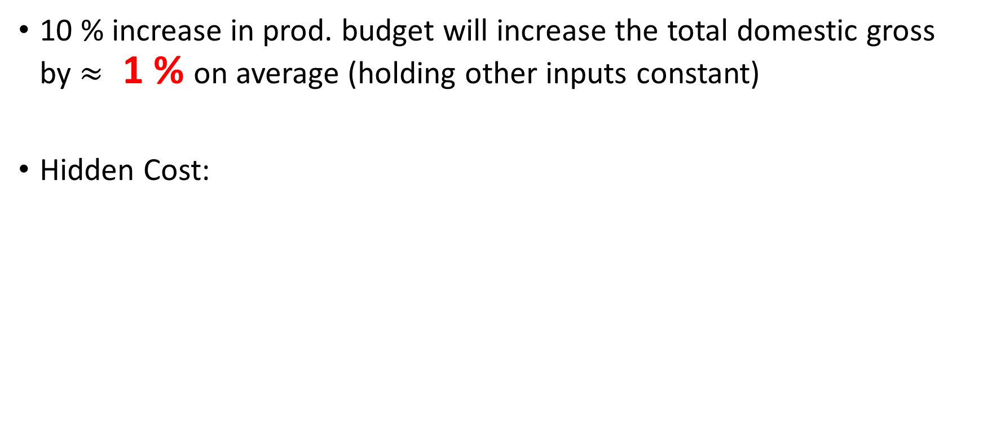
Production Budget
10 % increase in prod. budget will increase the total domestic gross by $≈$ 1 % on average (holding other inputs constant)
Hidden Cost:

Slide 36

Production Budget
10 % increase in prod. budget will increase the total domestic gross by $≈$ 1 % on average (holding other inputs constant)
Hidden Cost:
Marketing cost

Slide 37

Production Budget
10 % increase in prod. budget will increase the total domestic gross by $≈$ 1 % on average (holding other inputs constant)
Hidden Cost:
Marketing cost
Distribution cost

Slide 38
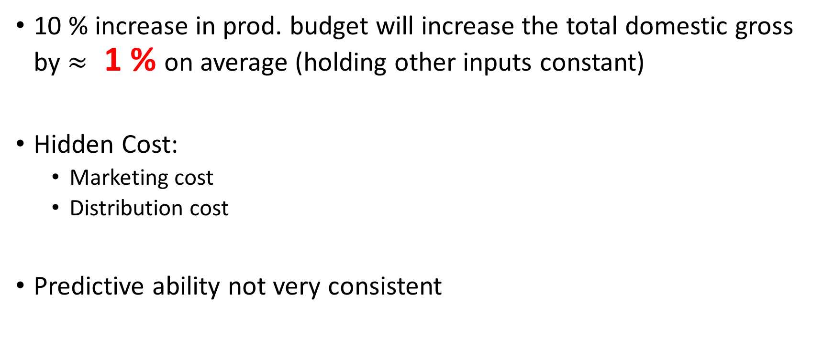
Production Budget
10 % increase in prod. budget will increase the total domestic gross by $≈$ 1 % on average (holding other inputs constant)
Hidden Cost:
Marketing cost
Distribution cost
Predictive ability not very consistent

Slide 39
Notes:
Taken from 2009 Liam Neeson

Slide 40
Opening Weekend Gross

Slide 41
Opening Weekend Gross
Very strong indicator of eventual success

Slide 42
Opening Weekend Gross
Very strong indicator of eventual success
Potential interaction with other variables

Slide 43
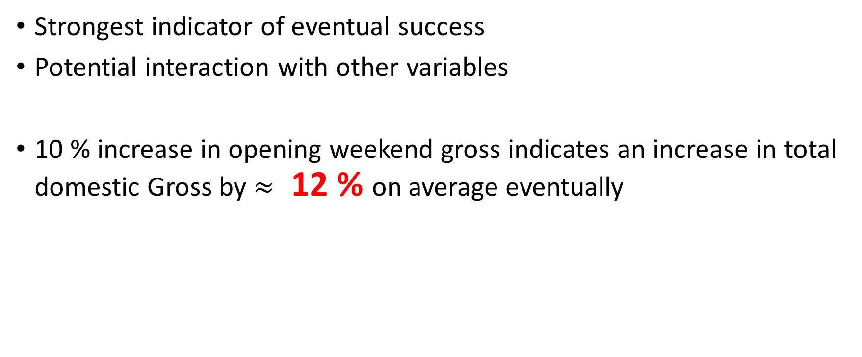
Opening Weekend Gross
Strongest indicator of eventual success
Potential interaction with other variables
10 % increase in opening weekend gross indicates an increase in total domestic Gross by $≈$ 12 % on average eventually

Slide 44
Key Conclusion

Slide 45
Key Conclusion
Pre-release: FB likes good indication of pre-release sentiment

Slide 46
Key Conclusion
Pre-release: FB likes good indication of pre-release sentiment
Immediate post-release: IMDB score and opening weekend gross

Slide 47
Key Conclusion
Pre-release: FB likes good indication of pre-release sentiment
Immediate post-release: IMDB score and opening weekend gross
In season releases movies easier to predict

Slide 48
Key Conclusion
Pre-release: FB likes good indication of pre-release sentiment
Immediate post-release: IMDB score and opening weekend gross
In season releases movies easier to predict
More and better data needed in order to tease out more precise relationship

Slide 49
Any Questions?

Slide 50
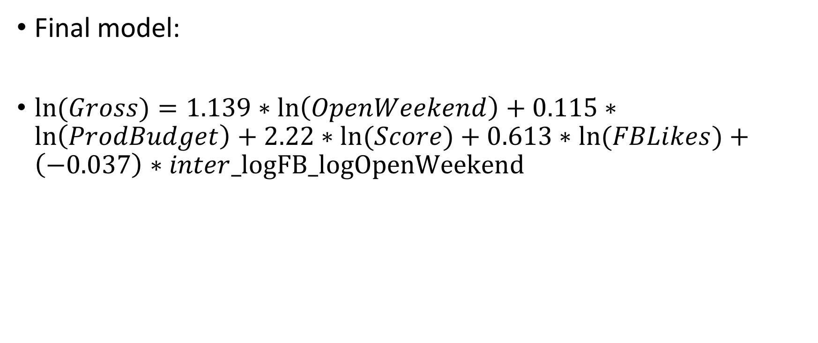
Appendix A
Final model:
$ln(Gross)=1.139∗\ln\left(OpenWeekend\right)+0.115∗\ln\left(ProdBudget\right)+2.22∗ln⁡(Score)+0.613∗ln⁡(FBLikes)+\left(−0.037\right)∗inter_logFB_logOpenWeekend$

Slide 51
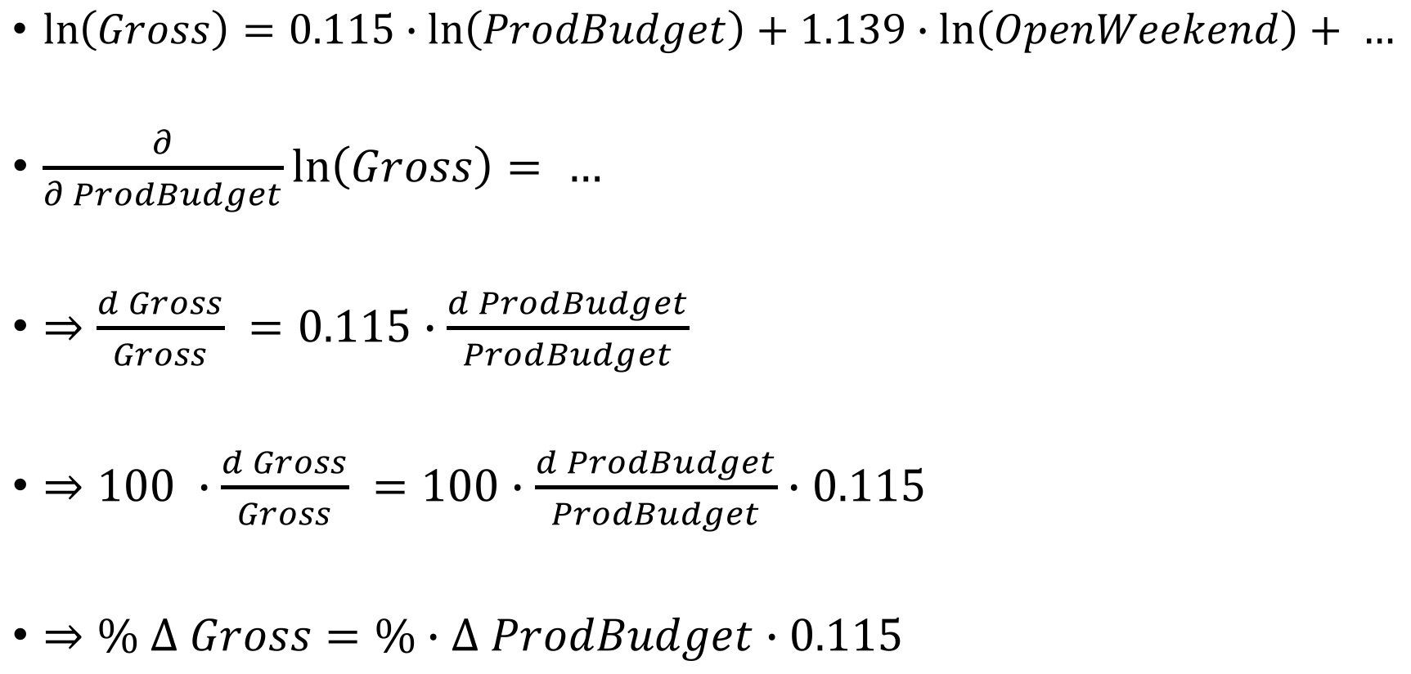
Appendix B
$\ln\left(Gross\right)=0.115∙ln\left(ProdBudget\right)+1.139∙\ln\left(OpenWeekend\right)+ …$
$\frac{∂}{∂ ProdBudget}\ln\left(Gross\right)= …$
$⇒\frac{d Gross}{Gross} =0.115∙\frac{d ProdBudget}{ProdBudget}$
$⇒100 ∙\frac{d Gross}{Gross} =100∙\frac{d ProdBudget}{ProdBudget}∙0.115$
$⇒\% ∆ Gross=\%∙∆ ProdBudget∙0.115$

Slide 52
Appendix C
#jthetzel

Slide 53
Appendix D

Slide 54
Thank you
github: willtseng12

